Slide 1
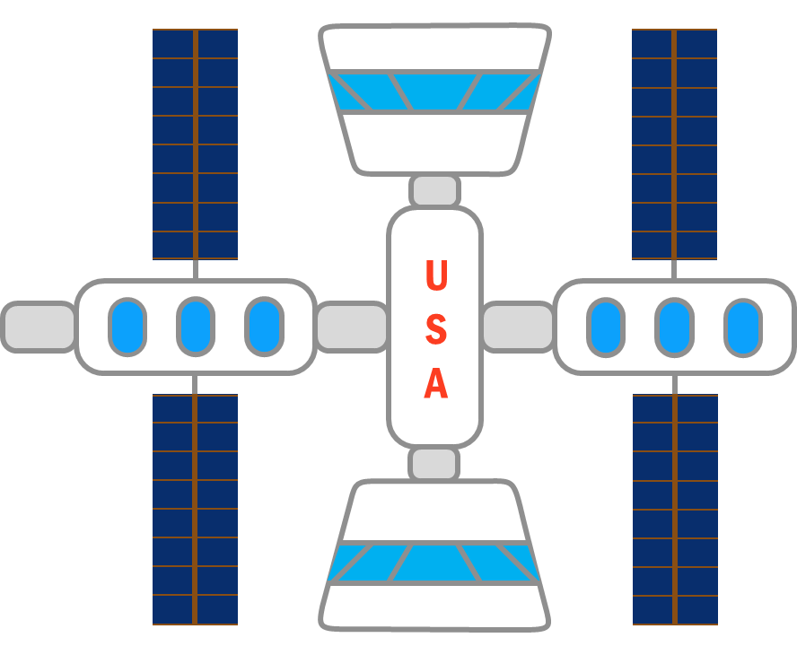
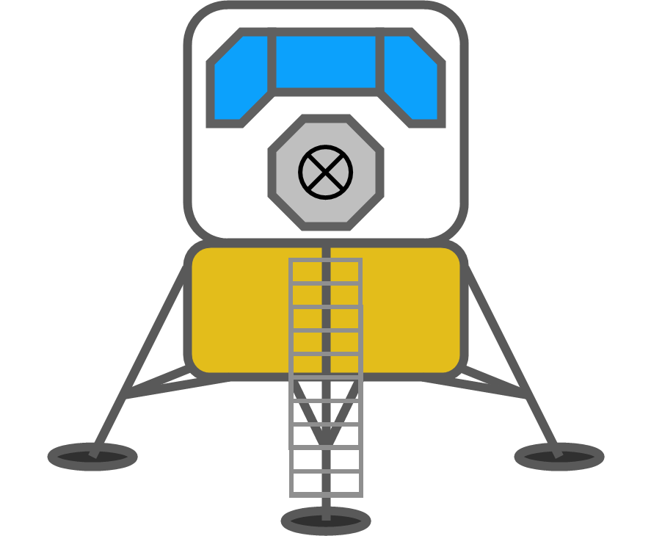
Reusable Shock Absorber for New Lunar Lander
Design Review 5
Team 515
January 23, 2021
1

Slide 2
Team Members
Team Members
Josh Blank
Design Engineer
Matt Fowler
Systems Engineer
Tristan Jenkins
Design Engineer
Alex Noll
Mechanical Engineer
Melanie Porter
Dynamics Engineer
Melanie Porter
2

Slide 3
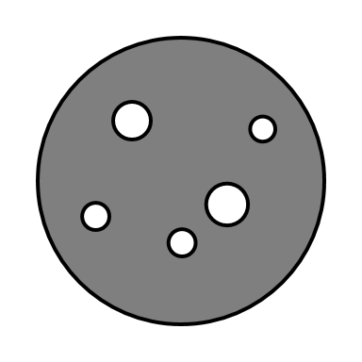
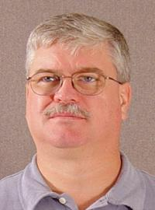
Sponsor & Advisor
Sponsor & Advisor
Project Sponsor
Rachel McCauley
MSFC Advanced Concepts Deputy Manager at NASA
Academic Advisor
Keith Larson
Teaching Faculty I
Melanie Porter

Slide 4
Objective
To design a reusable device for the human lander system that will dissipate the impact energy in such a way that it does not damage the vessel or occupants.
Melanie Porter

Slide 5
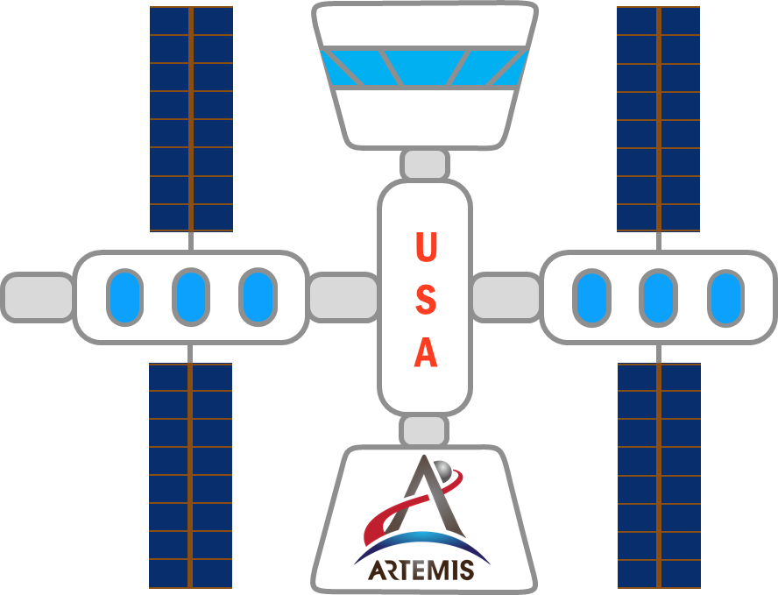
Project Description
Project Description
Melanie Porter

Slide 6
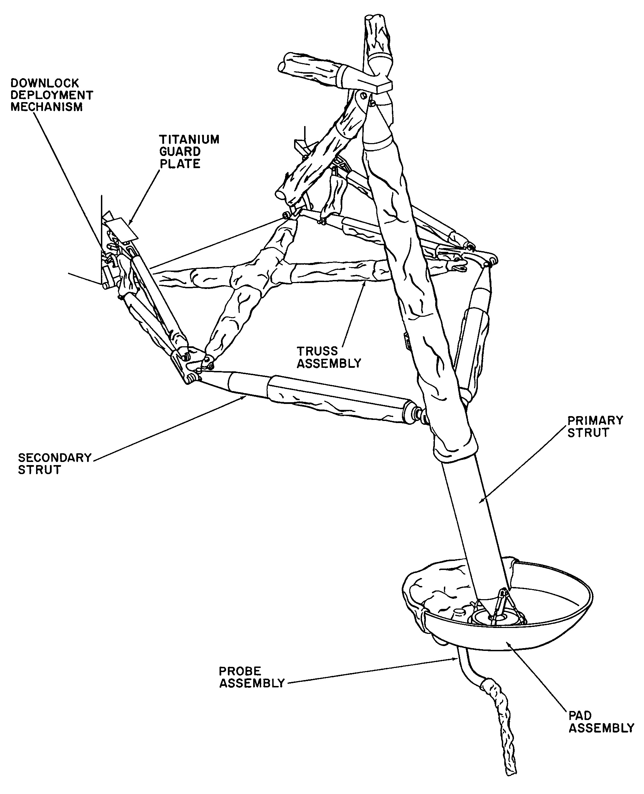
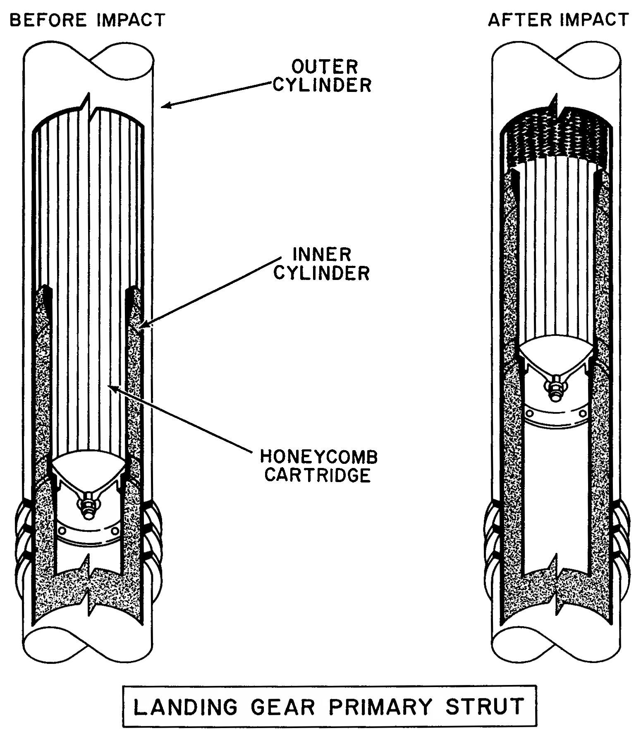
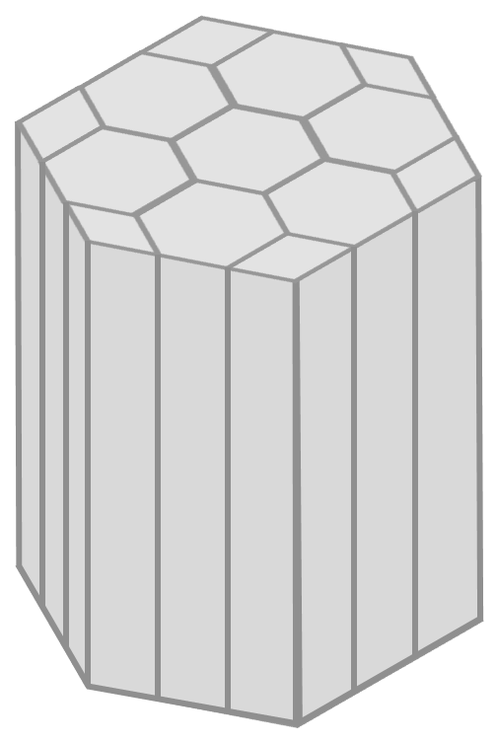
Apollo Shock Absorber
Apollo Shock Absorber
LANDING GEAR ASSEMBLY
[1]
ALUMINUM HONEYCOMB VISUAL AID
LANDING GEAR PRIMARY STRUT
[1]
Melanie Porter

Slide 7
Traditional Shock Absorbers
2) Fast Compression
No Fluids
1) Impact
3) Heat Dissipation
No Heat
Dissipation
4) Slow Expansion
Melanie Porter

Slide 8
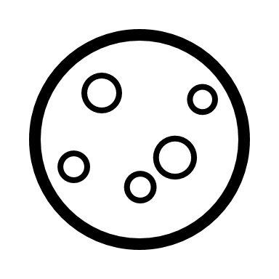
Functions
Previous Work
#1
Project Scope
Customer Needs
Background Research
Functional Decomp
Targets & Metrics
Concept Generation
Concept Selection
Link
Melanie Porter

Slide 9
1st Design Iteration
Pawl Arm: locks ratchet
Ferromagnetic Core
Linear Ratchet: compresses spring
Solenoid: pulls to release pawls
To Lander
Main Spring: stores energy
Locking Springs
Extension Spring:
closes pawls
Team 515
Con
Rev: 1
Page 1/1
T. Jenkins

Slide 10
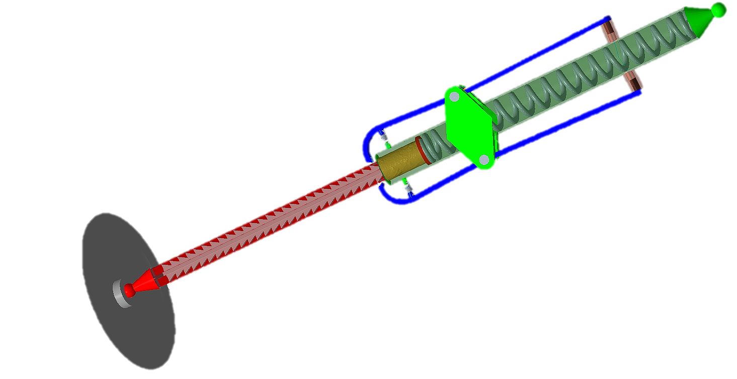
First Design Iteration
Tristan Jenkins

Slide 11
First Design Iteration
M_{pawl} = 0
F_{Friction}
F_{Extension}
F_{Solenoid}
F_{Main}
Extension Spring
Force
Length
Needed
8 kip
< 13 inches
Realistic
4 kip
> 200 inches
Tristan Jenkins

Slide 12
Root Cause Analysis
“We didn’t know that we had assumed.”
“Scale of forces is beyond our conception.”
Tristan Jenkins
Tristan Jenkins

Slide 13
X
2nd Design Iteration
“Vice Grips” style 4-bar linkage → Increase Mechanical Advantage
Still too much force!
Locking Springs
Team 515
Con
Rev: 2
Page 1/1
T. Jenkins

Slide 14
3rd Design Iteration
Pawl Connection
Keyed Motor Housing
Pawl
M
Motor
Locking Springs
Ratchet Screw
Thrust/Radial bearing
Team 515
Con
Rev: 3
Page 1/1
T. Jenkins

Slide 15
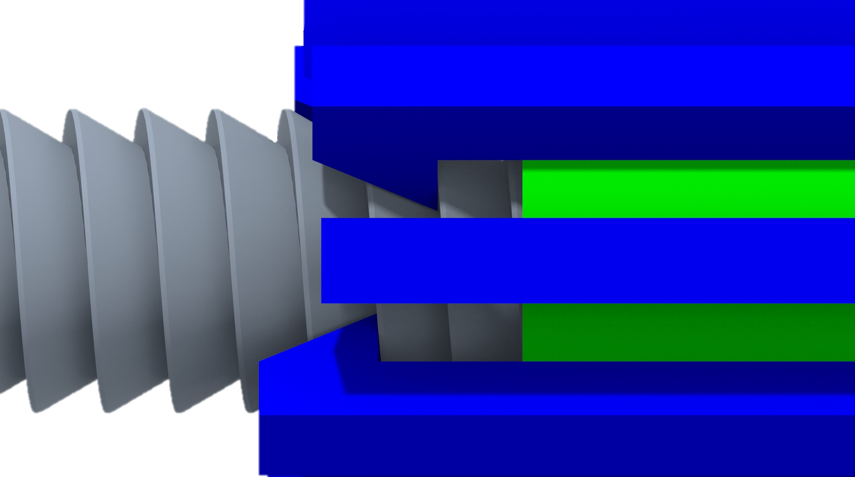
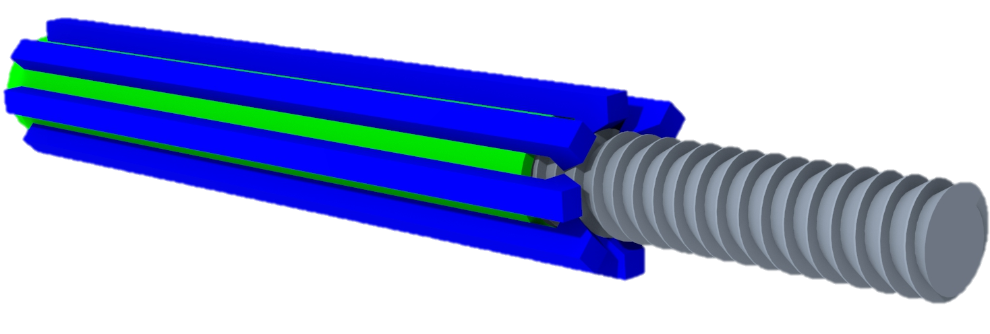
Ratchet Screw
Staggered Pawls
Ratchet Helix Profile
Angled Pawl Teeth
More Pawl Arms
Tristan Jenkins
15

Slide 16
Prototypes
Alex Noll

Slide 17
Spring Test Prototype
~1/3 Geometric scale
1/645 Force scale
kg
Test spring deflection on impact
Alex Noll

Slide 18
Locking Test Prototype
Same scales as spring prototype
Test ratcheting movement
Test pawls under load, 141 lbs
kg
kg
Alex Noll

Slide 19
Unlocking Test Prototype
Same scales as spring prototype
M
Test unlocking movement under load
Why a separate prototype?
kg
Alex Noll

Slide 20
Prototype Budget
Spring Prototype
Locking Prototype
Prototype
Price
%
Balance
Allotted
$2000
100%
Spring
$216
10.8%
Locking
$750
37.5%
Unlocking
$750
37.5%
Total
$1716
85.8%
Unlocking Prototype
Alex Noll

Slide 21
Big Takeaways
Alex Noll

Slide 22
Thank You!
Notes:
Thank you, I hope you’ve enjoyed our presentation. Are there any questions?

Slide 23
References
[1] Rodgers, W. F. (1972). Apollo Experience Report – Lunar Module Landing Gear Subsystem (NASA TN 0-6850). Washington , D.C. : National Aeronautics and Space Administration.
[2] INCO. (1974). Materials for Cryogenic Service: Engineering Properties of Austenitic Stainless Steels. Nickle Development Institute .

Slide 24
Backup Slides

Slide 25
Back Up Project Description

Slide 26
Back Up Functional Decomp
Functional Decomposition Cross Reference Table. Rows more important than columns
 | Withstand Shock | Support Weight | Absorb Impact Energy | Dampen Vibrations | Prevent Excessive Rebound | Transform Energy | Dissipate Energy | Store Energy | Return to Origingal State | Sum
Withstand Shock | - | 1 | 0 | 1 | 1 | 1 | 1 | 1 | 1 | 7
Support Weight | 0 | - | 0 | 1 | 1 | 1 | 1 | 1 | 1 | 6
Absorb Impact Energy | 1 | 1 | - | 1 | 1 | 1 | 1 | 1 | 1 | 8
Dampen Vibrations | 0 | 0 | 0 | - | 0 | 0 | 1 | 1 | 0 | 2
Prevent Excessive Rebound | 0 | 0 | 0 | 1 | - | 1 | 1 | 1 | 0 | 4
Transform Energy | 0 | 0 | 0 | 1 | 0 | - | 1 | 1 | 0 | 3
Dissipate Energy | 0 | 0 | 0 | 0 | 0 | 0 | - | 1 | 0 | 1
Store Energy | 0 | 0 | 0 | 0 | 0 | 0 | 0 | - | 0 | 0
Return to Origingal State | 0 | 0 | 0 | 1 | 1 | 1 | 1 | 1 | - | 5
Rank | 2 | 3 | 1 | 7 | 5 | 6 | 8 | 9 | 4
Rank | Function
1 | Absorb Impact Energy
2 | Withstand Shock
3 | Support Weight
4 | Return to Original State
5 | Prevent Excessive Rebound
6 | Transform Energy
7 | Dampen Vibrations
8 | Dissipate Energy
9 | Store Energy

Slide 27
Back Up Concept Selection: HoQ
 | Importance rating | Absorb Impact Energy | Absorb Structural Shock | Support Mass | Return to Original State | Indicate Reusability | Prevent Excessive Rebound | Transform Energy | Dampen Vibrations | Dissipate Energy | Store Energy | Withstand Lunar Conditions
The product can be used indefinitely. | 3 | 3 | 2 | 2 | 3 | 2 |  | 1 | 1 | 1 | 1 | 3
The product is lightweight. | 3
The product can be sent to the moon and used repeatedly. | 3 | 3 |  | 1 | 3 | 2 |  |  |  |  |  | 3
No routine maintenance is necessary during remainder of each lunar trip. | 1 |  |  |  | 2 | 1
Shock absorber dynamic qualities does not change or diminish after an impact. | 2 | 2 | 2 | 1 | 1 |  | 1 | 1 |  | 1 | 1
The product can handle an impact speed of 10 feet per second. | 3 | 3 | 3
The product can support 25,000 kg. | 2 |  | 3 | 3 |  |  | 2
The product can land at up to a 10-degree offset from the z-axis. | 1 |  |  |  |  |  | 1
Raw Score (total) | 146 | 31 | 21 | 17 | 21 | 13 | 7 | 5 | 3 | 5 | 5 | 18
Relative weight (%) | 100 | 21.23 | 14.38 | 11.64 | 14.38 | 8.90 | 4.79 | 3.42 | 2.05 | 3.42 | 3.42 | 12.33
Rank Order |  | 1 | 2 | 5 | 3 | 6 | 7 | 8 | 11 | 9 | 10 | 4

Slide 28
Back Up Concept Selection: Pugh 1
 |  | Concept
Selection Criteria | Datum | 1 | 2 | 3 | 4 | 5 | 6 | 7 | 8
Absorb Impact Energy | Apollo Shock Absorbers | - | s | + | + | + | s | + | s
Absorb Structural Shock |  | - | + | - | + | + | - | s | s
Support Mass |  | s | s | - | S | s | s | s | s
Return to Original State |  | + | + | + | + | + | + | + | +
Indicate Reusability |  | + | + | + | - | - | + | s | -
Prevent Excessive Rebound |  | - | - | + | + | + | + | + | +
Transform Energy |  | S | + | s | s | s | + | + | s
Dampen Vibrations |  | + | + | + | + | + | - | + | +
Dissipate Energy |  | s | + | s | s | s | + | s | s
Store Energy |  | s | s | s | + | s | + | + | s
Withstand Lunar Conditions |  | - | + | - | - | - | - | s | +
#of pluses |  | 3 | 6 | 5 | 6 | 5 | 6 | 6 | 3
# of minuses |  | 4 | 1 | 3 | 1 | 1 | 3 | 0 | 1

Slide 29
Back Up Concept Selection: Pugh 2
 | Concepts
Selection Criteria | Datum | 2 | 7 | 4
Absorb Impact Energy | Spider Legs | + | + | S
Absorb Structural Shock |  | + | + | +
Support Mass |  | s | + | -
Return to Original State |  | + | + | S
Indicate Reusability |  | s | - | +
Prevent Excessive Rebound |  | - | + | +
Transform Energy |  | + | + | +
Dampen Vibrations |  | - | + | +
Dissipate Energy |  | s | + | S
Store Energy |  | + | + | S
Withstand Lunar Conditions |  | s | + | -
#of pluses |  | 5 | 10 | 5
# of minuses |  | 2 | 1 | 2

Slide 30
Back Up Concept Selection: AHP 1
Criteria Matrix [c]
Customer Needs | Lightweight | Reusable | Dynamic qualities do not change after impact "hopping" | Reduce to <3Gs acceleration | Consistent tooling | handle impact 10ft/s | can support 25000kg | <10 degree offset from z axis
Lightweight | 1.00 | 0.33 | 0.33 | 0.20 | 3.00 | 0.14 | 0.20 | 0.33
Reusable | 3.00 | 1.00 | 3.00 | 0.33 | 5.00 | 0.20 | 0.33 | 3.00
Dynamic qualities do not change after impact | 3.00 | 0.33 | 1.00 | 0.20 | 3.00 | 0.20 | 0.20 | 0.33
Reduce to <3Gs acceleration | 5.00 | 3.00 | 5.00 | 1.00 | 5.00 | 0.33 | 0.33 | 3.00
Consistent tooling | 0.33 | 0.20 | 0.33 | 0.20 | 1.00 | 0.33 | 0.33 | 0.33
handle impact speed 10ft/s | 7.00 | 5.00 | 5.00 | 3.00 | 3.00 | 1.00 | 3.00 | 5.00
can support 32800kg | 5.00 | 3.00 | 5.00 | 3.00 | 3.00 | 0.33 | 1.00 | 5.00
<10 degree offset from z axis | 3.00 | 0.33 | 3.00 | 0.33 | 3.00 | 0.20 | 0.20 | 1.00
Sum | 27.33 | 13.20 | 22.67 | 8.27 | 26.00 | 2.74 | 5.60 | 18.00

Slide 31
Back Up Concept Selection: AHP 2
Normalized Matrix |  |  |  |  |  |  |  |  | {W}
Lightweight | 0.04 | 0.03 | 0.01 | 0.02 | 0.12 | 0.05 | 0.04 | 0.02 | 0.0403
Reusable | 0.1098 | 0.0758 | 0.1324 | 0.0403 | 0.1923 | 0.0729 | 0.0595 | 0.1667 | 0.1062
Dynamic qualities do not change after impact | 0.1098 | 0.0253 | 0.0441 | 0.0242 | 0.1154 | 0.0729 | 0.0357 | 0.0185 | 0.0557
Reduce to <3Gs acceleration | 0.1829 | 0.2273 | 0.2206 | 0.1210 | 0.1923 | 0.1215 | 0.0595 | 0.1667 | 0.1615
Consistent tooling | 0.0122 | 0.0152 | 0.0147 | 0.0242 | 0.0385 | 0.1215 | 0.0595 | 0.0185 | 0.0380
handle impact speed 10ft/s | 0.2561 | 0.3788 | 0.2206 | 0.3629 | 0.1154 | 0.3646 | 0.5357 | 0.2778 | 0.3140
can support 32800kg | 0.1829 | 0.2273 | 0.2206 | 0.3629 | 0.1154 | 0.1215 | 0.1786 | 0.2778 | 0.2109
<10 degree offset from z axis | 0.1098 | 0.0253 | 0.1324 | 0.0403 | 0.1154 | 0.0729 | 0.0357 | 0.0556 | 0.0734
Sum | 1 | 1 | 1 | 1 | 1 | 1 | 1 | 1 | 1.0000

Slide 32
Back Up Concept Selection: AHP 3
Weighted Sum Vector {Ws} | {W} | {Cons}
0.352 | 0.0403 | 8.737873 |  | n | 8
0.992 | 0.1062 | 9.337189 |  | lambda | 9.181082
0.488 | 0.0557 | 8.754142 |  | RI | 1.4
1.546 | 0.1615 | 9.571901 |  | CI | 0.168726
0.323 | 0.0380 | 8.492243 |  | CR | 0.120519
3.004 | 0.3140 | 9.567303
2.080 | 0.2109 | 9.863322
0.670 | 0.0734 | 9.124682
 | Average: | 9.181082

Slide 33
Back Up Spring Prototype
Spring Prototype Calculations
Stiffness Scaler | 0.00553 |  | 1 : 180.821
Length Scaler | 0.280 |  | 1 : 3.567
Force/Mass scaler | 0.00155 |  | 1 : 645.022
Mass for Const Vel | 38.758 | kg | 85.447 | lbs
Drop h for Cont Vel | 0.592 | m | 1.941 | ft
Proto Impact Eng | 225.048 | J

Slide 34
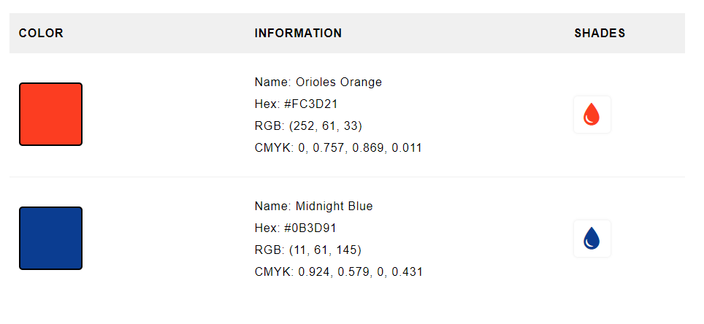
NASA Colors

Slide 35
Progress Trackers

